Slide 1

PWM DRAWER
By: Yasmin Mohamed Ali
Amit

Slide 2

Contents
Introduction
Project Description
Flow Chart
Hardware Components
Connections
Software
Project Code and Video

Slide 3

Introduction

Slide 4
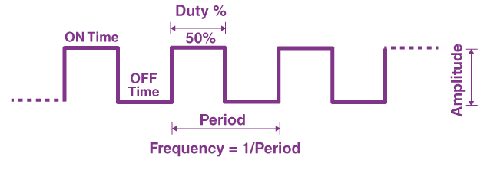
PWM Drawer
PWM Drawer is a Mini Oscilloscope Used to Display Frequency and The Waveform of The Generated PWM Wave.
What is PWM?
PWM is A Method of Controlling The Average Power or Amplitude Delivered By an Electrical Signal. The Average Value of Voltage Fed to The Load is Controlled By Switching The Supply Between 0 & 1 at a Fast Rate to Get Analog Values Between 0 and 1.

Slide 5

Project Description

Slide 6
Project Description
In This Project We Will Interface Atmega32 with GLCD to make PWM Drawer That Will Display The PWM Wave Generated By The Internal Clock Source in The Microcontroller.
The PWM Wave Will Be Generated By Timer2 in The Microcontroller Using Fast PWM Mode and Will Be Captured By ICU (Input Capture Unit) In Timer1.

Slide 7

Flowchart

Slide 8
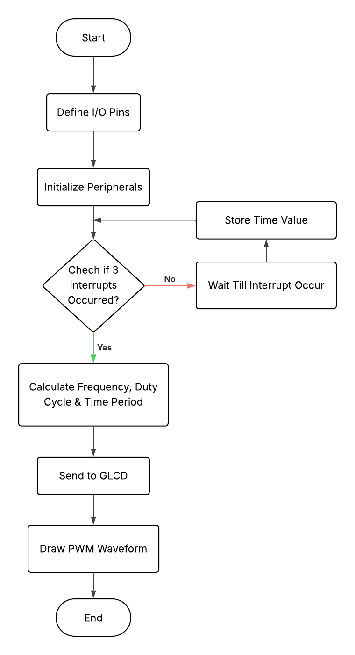
Flow Chart

Slide 9
Hardware Components

Slide 10
Hardware Components
Atmega32
GLCD (Graphical Liquid Crystal Display)
Potentiometer
Resistance (0.5KΩ)

Slide 11
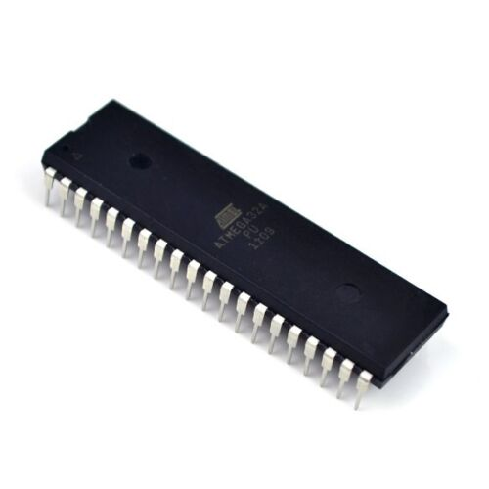
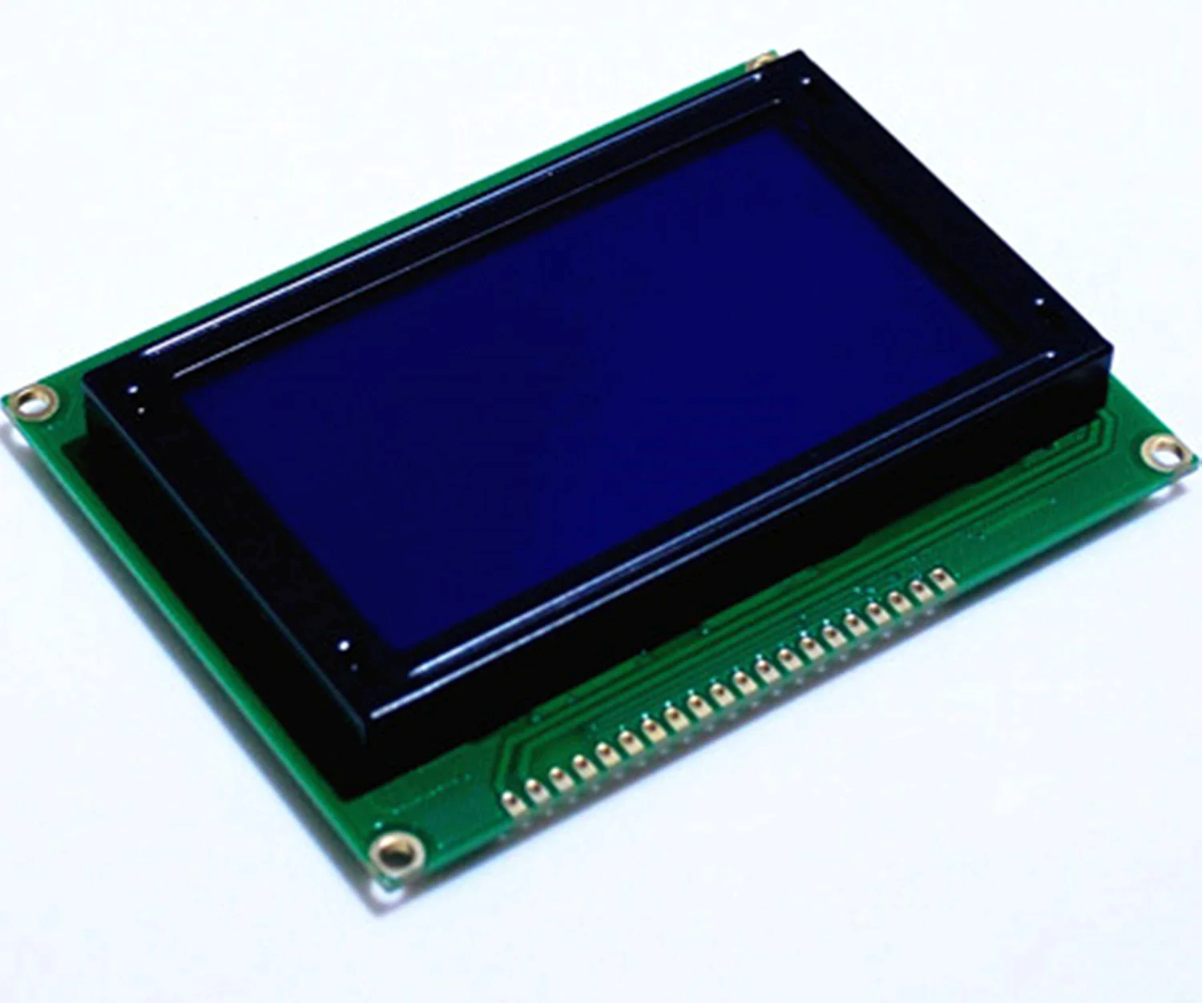
Atmega32
We Will Use Atmega32. Our Microcontroller is Set To Use Internal Clock Source At 16MHZ.
GLCD (Graphical Liquid Crystal Display)
It Is An LCD Able To Display Images, Letters And Numbers.
It Has 128x64 Pixels In 128 Columns And 64 Row Segments.

Slide 12

Connections

Slide 13
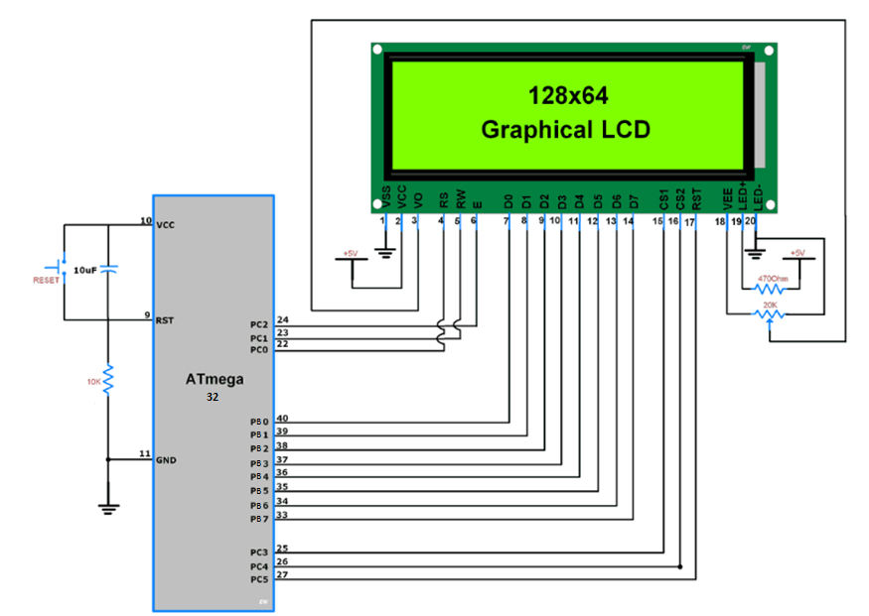
Connections

Slide 14

Software

Slide 15
Software
Timers
Timers are used to generate time delays, waveforms, or to count events. Also, for PWM generation, capturing events, etc.
We Will Use Timer2 to Generate PWM Wave using Fast PWM Mode From OC2 Pin.
Timer1 Which has The ICU will be used to Capture PWM Signal Using ICP1 Pin.
Interrupts
Interrupts are Events That are Higher Priority. When They Occur, The MC Goes From Background System to Foreground System to Handle them.
We will Enable ICU Interrupt To Capture The PWM Signal. Also, Global Interrupt Must be Enabled to Allow Interrupts to The MC.

Slide 16
Project Code & Video
Project Code
https://github.com/YasminNassar/PWM-Drawer
Project Video
https://drive.google.com/file/d/18oHS1vqbhf04olyJqDs_nsY8_ISKli90/view?usp=drivesdk

Slide 17

Thank You

